Slide 1
Topics in Deep Learning UE16CS414
“Generation of Abstract Summaries for Food Reviews using a Sequence to Sequence Architecture with Local Attention Mechanism ”
Abhishek Narayanan 01FB16ECS016
Abhishek Prasad 01FB16ECS017
Abijna Rao 01FB16ECS019

Slide 2
PROBLEM STATEMENT
This project is aimed at implementing a deep learning model for performing Abstractive Summarization of fine food reviews from Amazon using a Sequence to Sequence architecture, incorporating local attention mechanism for an improved performance compared to the standard vanilla version of the encoder decoder architecture. We also implement a bidirectional LSTM for the encoder to account for context in both forward and backward directions, while the decoder uses the standard unidirectional LSTM.

Slide 3
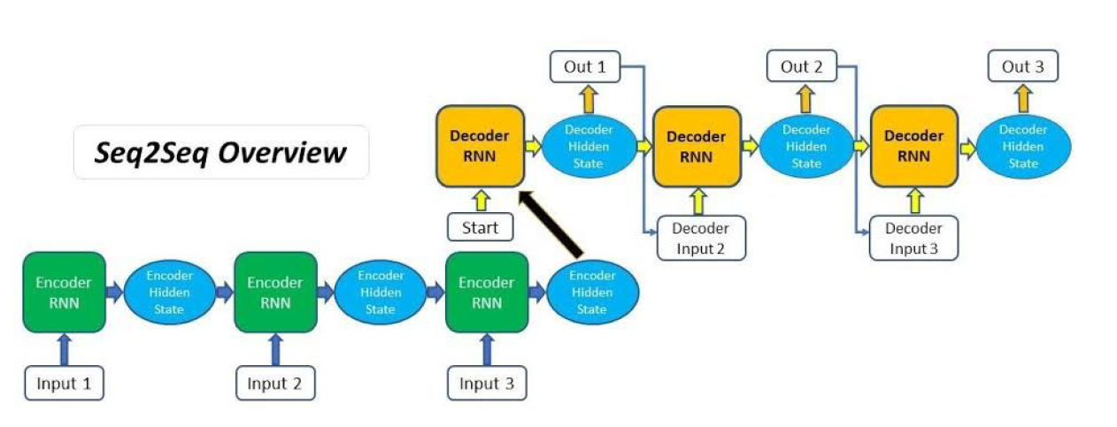
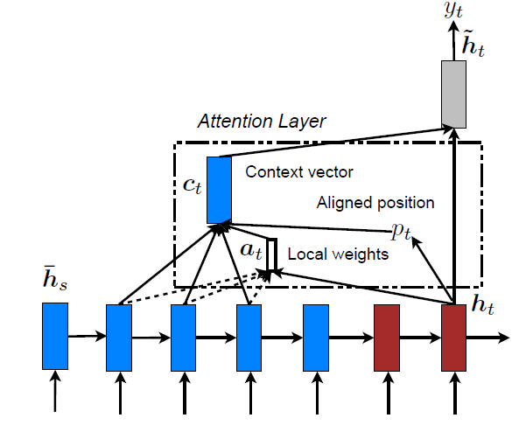
PROPOSED METHODOLOGY

Slide 4
ARCHITECTURE
The encoder RNN cells are implemented as Long Short Term Memory cells (LSTMs) rather than the vanilla simple RNNs which are prone to the vanishing gradient problem and thus are incapable of capturing context over long sequences of text.
We employ Bi-Directional LSTM encoder in order to capture context in both forward and backward directions.
We additionally incorporate Local Attention in our model in an attempt to generate better results.

Slide 5
DATASET USED
For the purpose of training a sequence to sequence model to learn summarization of text reviews, we use the Amazon Fine Food Reviews data, procured from Kaggle website. This dataset consists of reviews of fine foods from amazon. The data span a period of more than 10 years, including all approximately 500,000 reviews up to October 2012. Reviews include product and user information, ratings, and a plain text review. It also includes reviews from all other Amazon categories.

Slide 6
RESULTS
Sample Text
for those who like a bold , strong flavored coffee . this <UNK> is a must try . for those who are new to k cups try a variety pack first tp help you better decide your favorite coffee blends .
Sample Predicted Summary
great coffee
Sample Actual Summary
good coffee

